Slide 1
District Safety Plan 2019-20
Jaime Alicea
Superintendent of Schools

Slide 2
Components of the District Safety Plan
SYRACUSE CITY SCHOOL DISTRICT
2019-20
District Safety Action Plan
Recommendations
EMERGENCY RESPONSE PLAN
Jaime Alicea, Superintendent of Schools
2019-20

Slide 3
District Wide Safety Action Plan Updates
1. Adoption of the Standard Re-unification Method (SRM) and training for all District staff and students, though a contract with the State University of New York, College at Oswego
2. Facilitated communications organizational chart for law enforcement contact during an emergency
3. Identification of District resources which may be available for use during an emergency
4. TIPS 411 has been procured as the District platform for anonymous reporting of any potential threat, behavior and to improve communications between students, staff and the community
5. Raptor Emergency Management application to be utilized to schedule and practice all drills including lockdown and evacuation drills. Additionally, will support the SRM re-unification exercises
6. SRP and other pertinent training videos will be added to the existing Safe Schools Training Platform for all staff mandatory annual training

Slide 4
District Wide Safety Action Plan Updates
Threat Assessment
Define concerning and prohibited behaviors.
Determine a threshold level for law enforcement intervention.
Establish a two-level threat assessment process to include both school- and county based teams to identify threats, conduct case reviews, and follow up as needed.
Develop effective risk management options to include both mental health referrals and options within the juvenile justice system.
Conduct regular trainings for all vested stakeholders as well as the Level 1 and Level 2 threat assessment teams.

Slide 5
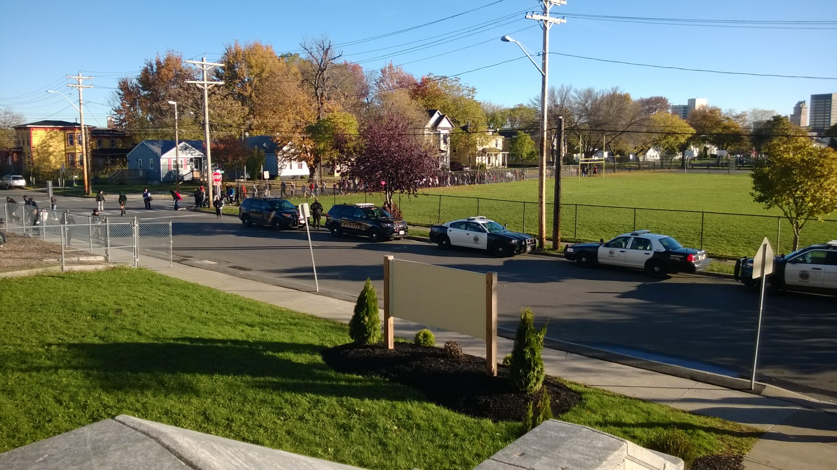
District Wide Safety Action Plan Updates
Memorandum of Understanding
Proposed Changes to Commissioner’s Regulation 155.17
Incorporate the requirements for adoption of an MOU into the requirements of Districtwide Safety Plan
Section 32 of Part YYY of Chapter 59 of the Laws of 2019
Every school district or charter school that employs or contracts with:
law enforcement or public or private security personnel, including school resource officers
•Must establish a written contract or memorandum of understanding (MOU) that delegates school discipline to school administration
•Must be adopted as part of the Districtwide School Safety Plan
•Effective July 1, 2019

Slide 6
Comments, Questions, Concerns

