Slide 1
Career Readiness Training
Syracuse City School District Career and Technical Education
Spring 2020

Slide 2
Career Readiness Workshop
Am I Ready for a full time job?
Job Application
Job Interview
Job Offer
I Got the Job….Now What?
Resources

Slide 3
Am I Ready?
Applying for and keeping a job is a commitment.
8 or more hours a day
40 hours a week
Working weekends and nights
Reliable Transportation
Notes:
Marianne

Slide 4
How Do I Apply: The Job Application
Most job applications are online
Fill it out…Honestly!!!
If not qualified….still apply
Check your spelling
Accurate cell phone and email address
Notes:
Sue

Slide 5
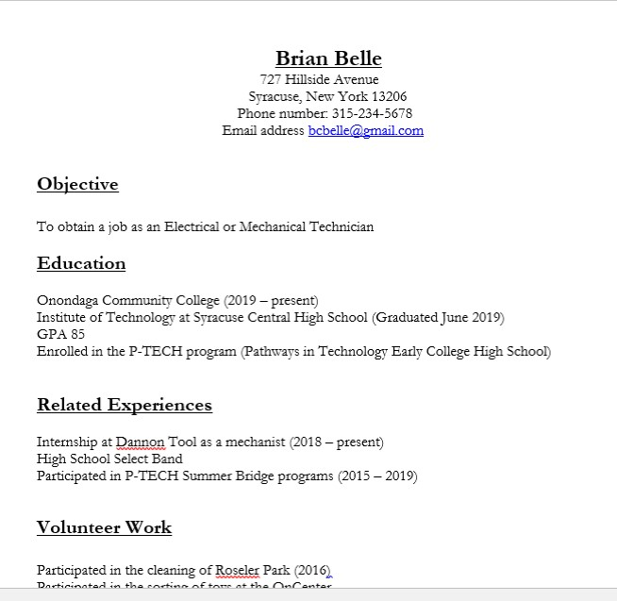
Resume
Resume
Document that lists your contact information, background, skills and accomplishments

Slide 6
References
People who can say something positive about your skills, attitude, and work experience
Teacher
Counselor
Coach
Mentor
No family
Ask permission

Slide 7
Job Interview: In person, Phone or Zoom
Be prepared…research, appearance, drug test, social media accounts
Speak clearly
Eye contact
Be confident
Be honest
Practice sample interview questions
Thank you email
Notes:
Nick

Slide 8
Job Interview Sample Questions
Tell Me About Yourself.
What interested you in this position?
Tell me about an accomplishment of which you're most proud.
What can you offer that others can't?
What would you say is your greatest strength and weakness?
Notes:
Nick
Talk about interest versus moving to another

Slide 9
Job Offer
Answer your phone and check email!!!
Respond and know what your are accepting
Confirm start date and time
Clothes, shoes, boots, ect… Dress for the job
Notes:
Marianne/Sue

Slide 10
I Got the Job…Now What?
Be early everyday
Do not miss work!!!
If you are sick, call your supervisor and explain
Have a positive attitude
Ask questions

Slide 11
Resources
SCSD web site
Under Departments, select CTE
Scroll to middle of the page for links
Notes:
Marianne

Slide 12
Questions

