Slide 1
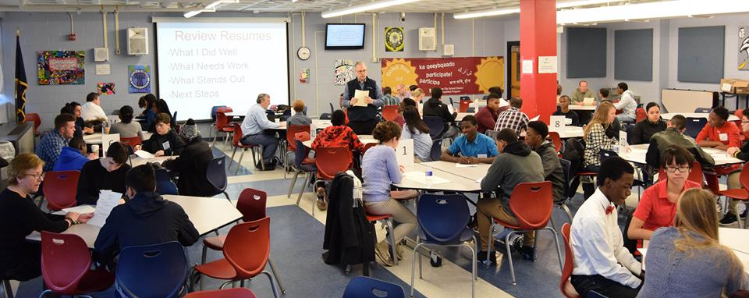
Preparing to Interview Career Coaches

Slide 2
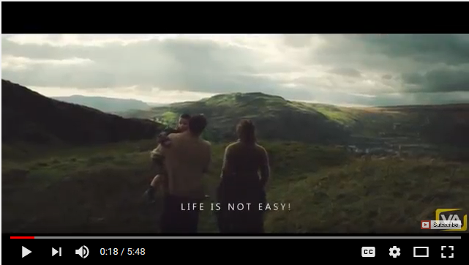
Career Coaching Preparation
Watch the video, then answer questions.
When finished, fold your paper and seal it in an envelope.
Write your name, program and the date on the front of the envelop.
https://m.youtube.com/watch?v=OKJImnk-gzQ

Slide 3
Review
Discerning - Having or showing good judgement.
Important for everyone to think about as you begin working with your career coaches.
You are building relationships with professionals.
It’s the start of your long-term job interview.

Slide 4
Career Coach Event
On Tuesday, October 23rd you will meet with your career coaches.
Working in teams of 2-3, you will interview a career coach about their job and the company they work for.
You will be given questions to ask…and make your own too.
You will use the information to create a digital presentation about your coach, their job and their company.

Slide 5
Career Coach Interviews
Every student will be responsible for all questions. You will be graded.
Each student should ask at least one question.
Take your time!!! Ask the questions slowly and be sure you write down the answer in complete sentences.
If your coach answers a question and you don’t understand it, ask them to explain.

Slide 6
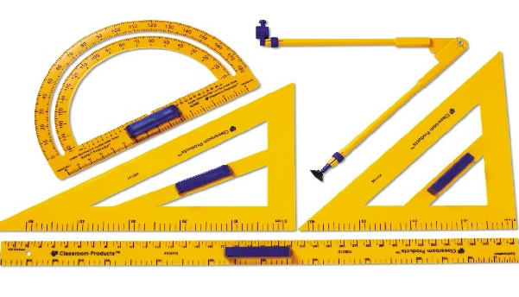
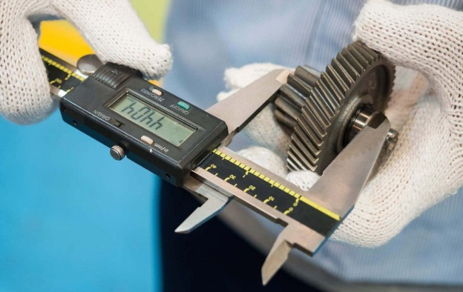
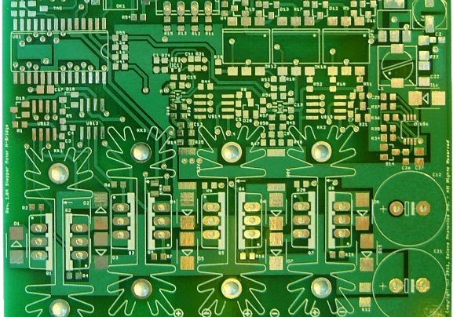
Career Coach Interviews
They may bring an item they use at their job. If they do, ask them to describe. Take a photo or a video of it for your presentation.
You will create the presentation in your technology class.

Slide 7
Career Coach Interviews
You will show the presentation to your coach the next time you meet.

Slide 8
Meeting the Coaches

Slide 9
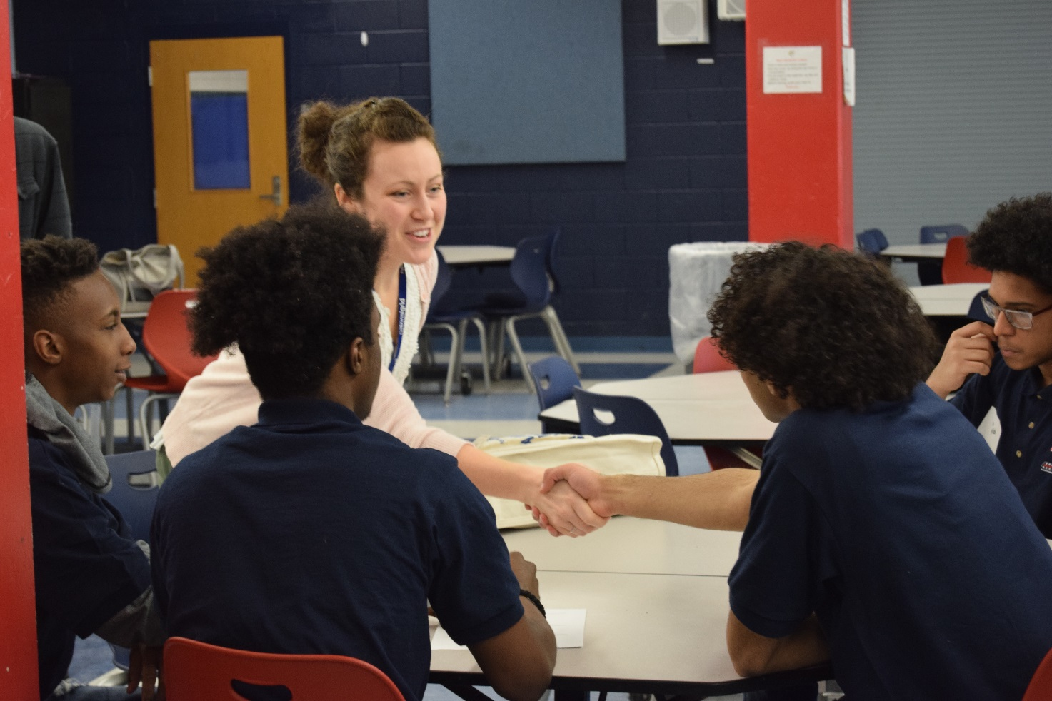
Career Coach Interviews
When you meet the career coach…make a great first impression.
Look them in the eyes, smile and shake their hand…firmly.
How does your breath smell?

Slide 10
Career Coach Interview
Using a loud voice, tell them your name and that you’re happy to meet them.
Sit down and begin to work.
Look them in the eyes, ask questions, listen to the answers and write them down.

Slide 11
Career Coach Interviews
When the event is over, thank them for coming, shake hands to say good by.

Slide 12
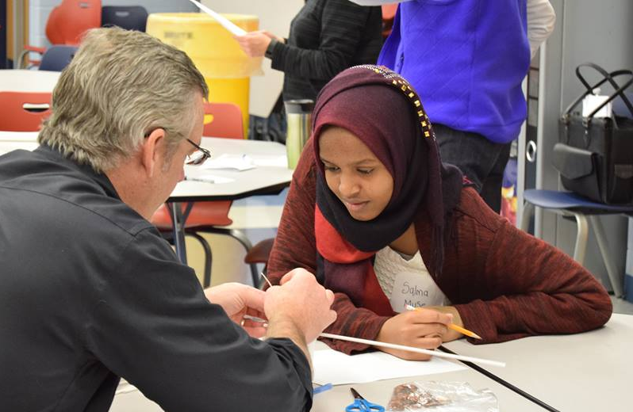
How To Dress…Business Casual

Slide 13
Dress “business casual”
Less formal than traditional business wear, but is still intended to give a professional and businesslike impression.

Slide 14
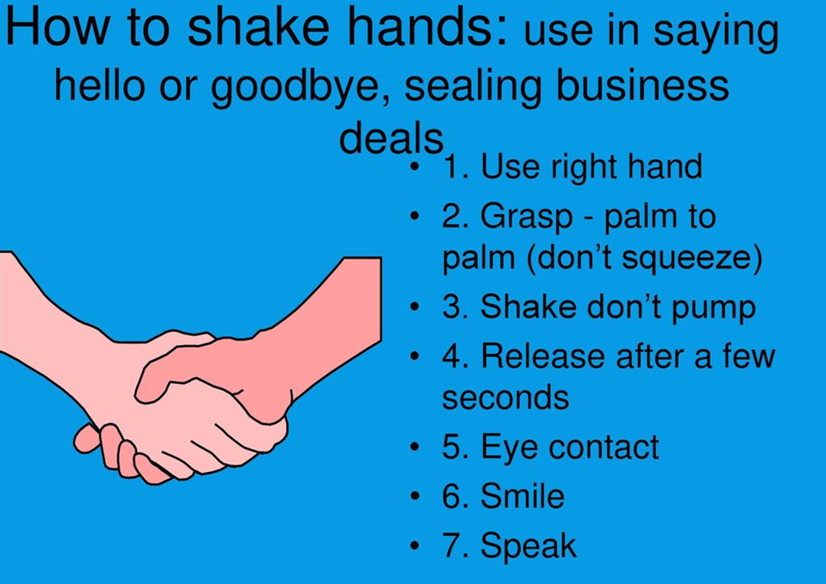
Lets Practice
Working with your partner, introduce yourself and ask the provided questions. Write down the answers.
Then switch roles.
Important!!!
Look them in the eyes
Smile
Reach out with your right hand and shake firmly
Sit and begin the interview.
When finished shake hands and say Thank you.

Slide 15
How Did You Do?
Share Out…
With a table partner share how you felt during this exercise.
On a scale of 1-10 rate yourself in how you did.
10 – I GOT THIS!!! Hired on the spot!!!
1 – I Have no idea what I’m doing!!!

