Slide 1
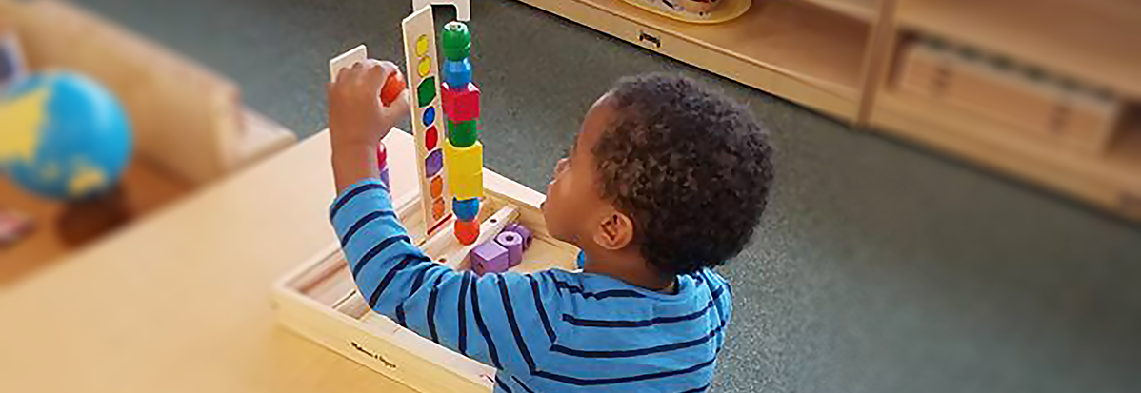
2021 Information Sessions
2/4/2021
2/11/2021

Slide 2
Montessori School at LeMoyne Mission Statement
In a carefully prepared environment, The Montessori School at LeMoyne will nurture the child’s intellectual, social and emotional development by applying the philosophy and methods of Dr. Maria Montessori. Students will:
Collaborate and learn with others in multi-age classrooms
Explore the curriculum using hands-on, self-correcting materials
Exercise freedom of choice to develop self-discipline, self-confidence, and intrinsic motivation
Practice social responsibility and self-awareness to contribute to a positive, peaceful climate and culture
Our school will partner with families and the community to promote peace and social responsibility.

Slide 3
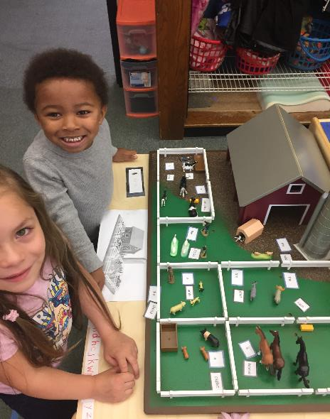
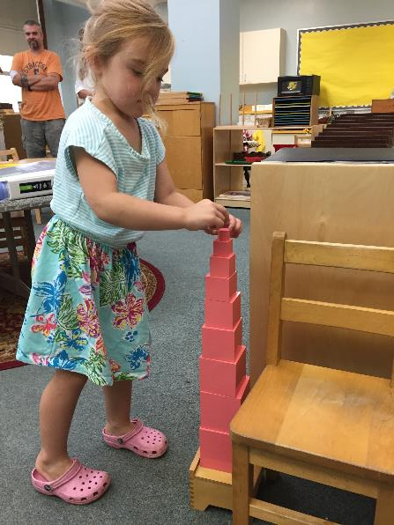
Working Together and/or Independently

Slide 4
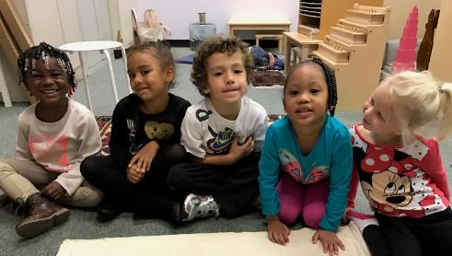
What is Montessori School at LeMoyne?
A school that is characterized by:
  multi-age classrooms
  a special set of educational materials
  student-chosen work in longer time blocks
  collaboration
  the absence of grades
  individual and small-group instruction in both academic and social skills
This approach lends itself to students who can work independently and enjoy the challenge of learning at their own pace, building independence as learners, while being motivated by an intrinsic desire to satisfy their inquiry.
A public elementary school with admission open to students AGE 3 for the 2020-2021 school year. Must turn 3 on or before 12.1.21.
An opportunity for students to receive a rigorous academic program based on the Montessori method.
What is it?

Slide 5
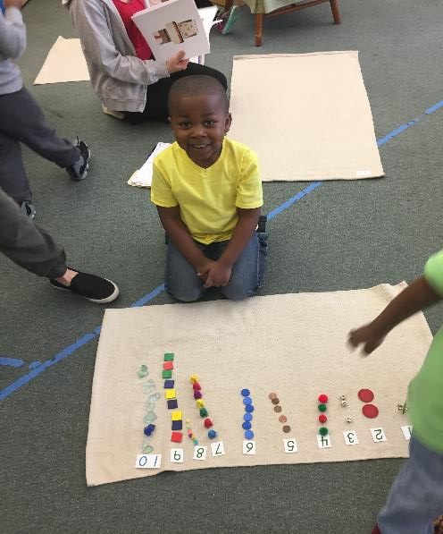
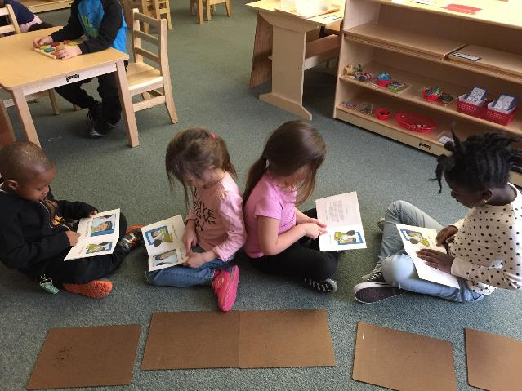
Hands on, active learning!

Slide 6
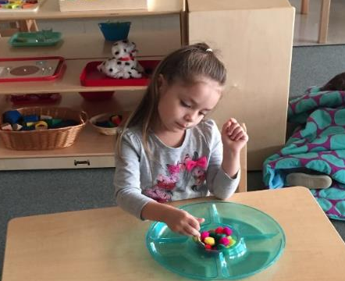
How is the Montessori School at LeMoyne Structured?
2021-2022 School Year | Ten Classes for students ages 3, 4, 5 Six classes for students ages 6, 7, 8 Two classes for students age 9
Future | Montessori School at LeMoyne will continue to grow ONE (1) age level per year into a 3-10 year old school by 2023
What is it?

Slide 7
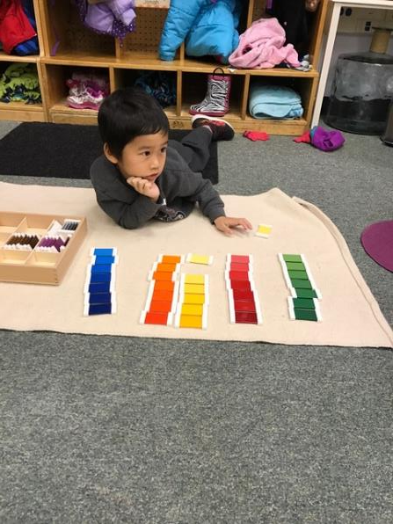
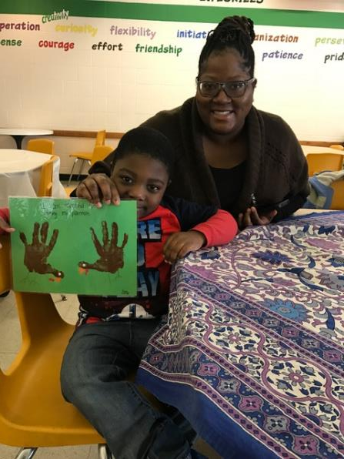
Challenging themselves, Involving Parents

Slide 8
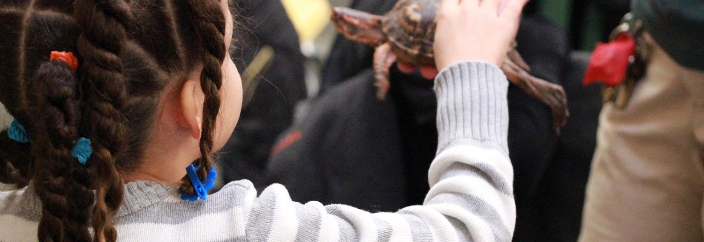
Montessori Method

Slide 9
What is the Montessori Method?
A challenging, multisensory approach to learning
Focus on developing the whole child
Children self select learning activities based on their interests
Children progress at their own rate
Multi-age classrooms
Focus on social-emotional development as well as academic development
Teachers facilitate learning
Article Link: What is a Montessori Education?
Montessori Method

Slide 10
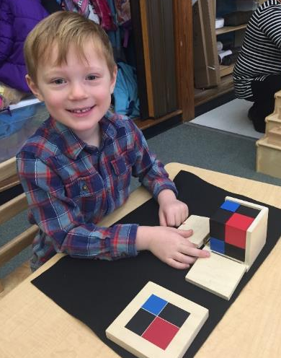
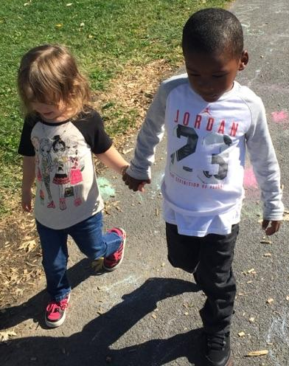
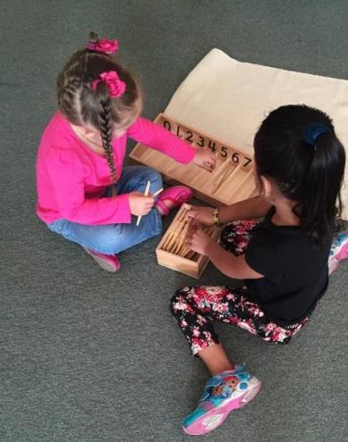
What it looks like at the Montessori School at LeMoyne?
Working Together
Working Independently
Becoming Great People, not
just Great Students!
Montessori Method

Slide 11
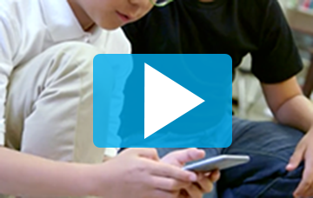
Montessori: The Elementary Years
From the American Montessori Society
Montessori Method

Slide 12
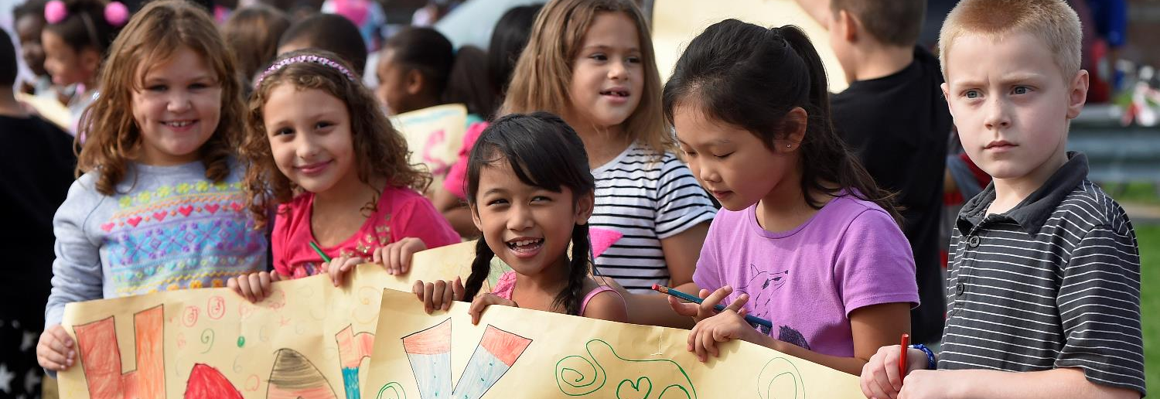
Program Overview

Slide 13
Montessori at LeMoyne Teachers
Montessori Certification Program
Partnerships with Buffalo Montessori Teacher Education Program and Seacoast Center Montessori Teacher Education Program with a Montessori Certification Program specifically designed for Montessori School at LeMoyne teachers.
*The first cohort of teachers completed their Montessori Certification in the summer of 2018. Cohort 2 finished in April 2020. Cohort 3 finishes in August 2021.
Overview: Teachers

Slide 14
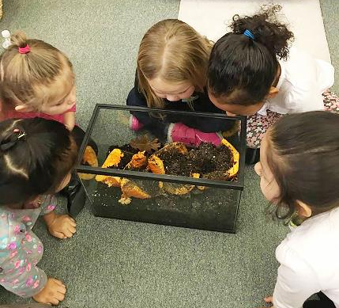
Schedule
Sample Early Childhood Schedule
8:40-9:00 | Student Arrival and Breakfast
9:00-11:30 | Uninterrupted Work Cycle Students receive lessons and/or choose works for themselves. Teachers guide, observe, provide lessons.
11:30-12:00 | Lunch
12:00-12:20 | Recess
12:20-12:30 | Care for the environment
12:30-1:15 | Targeted Work/Art/Music/PE/Library
1:20-2:30 | Enrichment/Targeted Instruction/Interventions
2:30-2:45 | Classroom Jobs/Care of the Environment
2:45 | Get ready for Dismissal
3:00 | Dismissal
Overview: Schedule

Slide 15
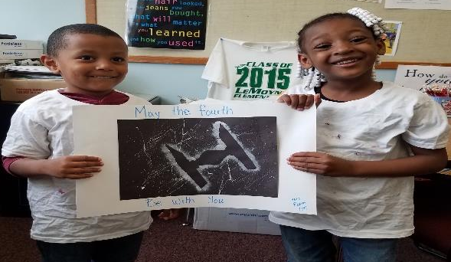
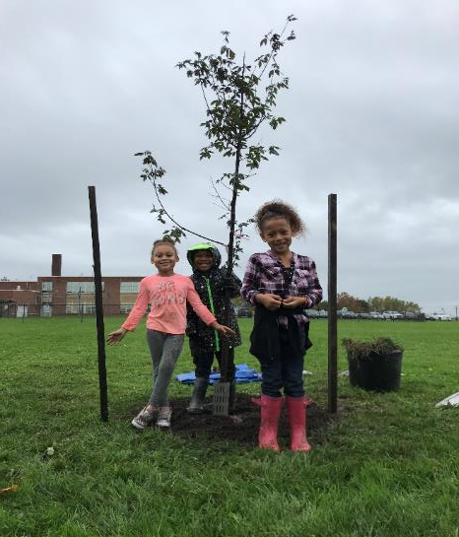
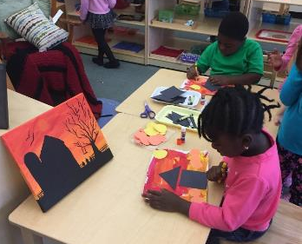
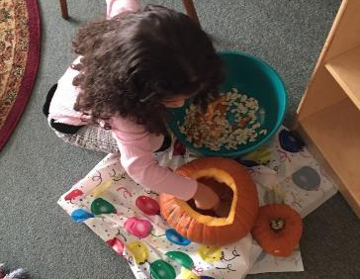
Enrichment
Overview: Enrichment

Slide 16
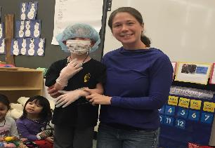
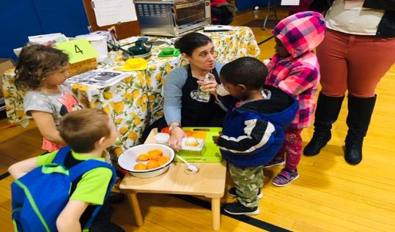
Family Involvement
Montessori School at LeMoyne Parent Group
Participate in “Family Fun Nights” – get to know other families!
Volunteer Opportunities at the School or from home
Be a “Mystery Reader”, “Guest Presenter”, “Visiting Artist”, and more!
Join the School Leadership/Academic Leadership /School Climate Teams
Overview: Family Involvement

Slide 17
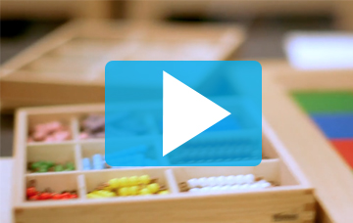
Living Montessori: The Parent Perspective
From the American Montessori Society
Overview: Parent Video

Slide 18
Transportation & After-School Programming
Yellow bus transportation will be provided for students who live more than 1.5 miles from school.
Free After-School program for students who are at least Kindergarten age.
Possible fee-based childcare for pre-k aged students.
Overview: Transportation

Slide 19

Admissions

Slide 20
Admissions Process Timeline
February 4 and February 11
Information Sessions
February 1- March 31
www.enrollinsyracusecityschools.com
Select the Montessori School at LeMoyne from the list of options
On or Before May 31st
(date is subject to change)
If the District receives more applications for this program than there are seats available, we will conduct a lottery using the Smartchoice Online Lottery System.
On or before June 15 (date is subject to change)
The Department of Student Registration will notify families with the results of the lottery; if your child has a seat at the Montessori School at LeMoyne or was placed on the waitlist. Parents/guardians will not be required to confirm acceptance of their seats. Students who are accepted in the lottery will be automatically assigned to the school. Parents/Guardians will be required to decline the seat via correspondence with the Department of Student Registration on or before June 21, 2019.
Admissions

Slide 21
Enrollment Expectations
Complete the admissions process to enter the lottery (register and also apply for Montessori).
Complete the registration process if selected.
Plan to have your child enrolled until middle school.
Transfers after age 4 are done through the district voluntary transfer process. You are not automatically moved to your home school at any point. We expect our students to stay at Montessori until Middle School.

Slide 22

Contact Information
The Montessori School at LeMoyne
jarmstrong2@scsd.us
(315) 435-4590
Admissions:
315-435-4545
Contact

