Slide 1
The Ongoing Journey From Compliance to Capacity
Corey Williams, PhD
Syracuse City School District
5/19/2017

Slide 2

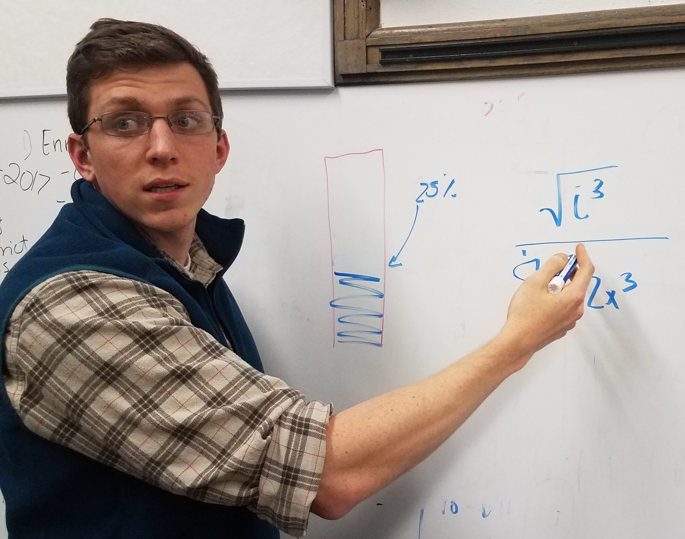
Co-Presenter
Dennis Robillard
John Cassidy Robillard

Slide 3
Overview
Welcome and Introduction
Historical Context
SchoolSTAT
Lessons Learned/Takeaways

Slide 4
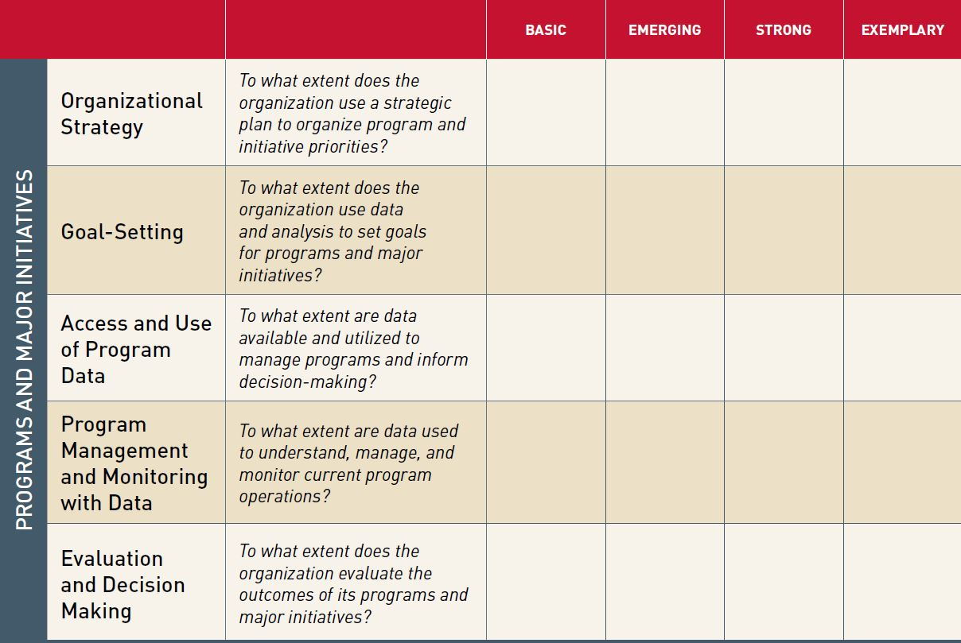
Turn and Talk
Source: Strategic Use of Data Rubric: Self-assessment tool. 2014. Strategic Data Project, Center for Education Policy Research at Harvard University.

Slide 5
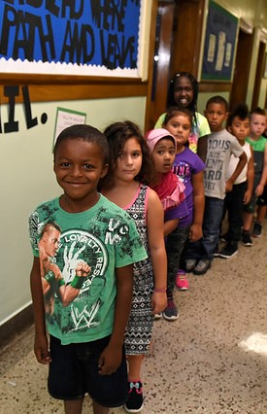
SCSD Background
34 Schools, 4 Alternative Programs
4 Traditional High Schools
2 CTE-Centered High Schools
6 Middle Schools
5 PK-8 Schools
17 Elementary Schools
4 Alternative Education Programs

Slide 6
SCSD Background
21,323 PK-12 Students
77% Economically Disadvantaged
20% with IEP/504
17% with Limited English Proficiency
65+ Languages Spoken

Slide 7

SCSD Background
Golden Snowball winner 16 of last 20 years

Slide 8
Assurance of Discontinuance (AOD)
2013 – Office of the Attorney General begins investigation into procedural safeguards for students
2012 Disciplinary Rates

Slide 9

Assurance of Discontinuance (AOD)
July 2014 – AOD signed by District and OAG
46 page legal compliance document
35 provisions to be monitored

Slide 10


Compliance to Capacity
AOD Outlines structures, not outcomes
Years 1 and 2 – Focus on developing systems and structures
No change in disproportionality
Year 3 – Focus on changing disproportionate outcomes

Slide 11

Compliance to Capacity
District commitment to addressing disproportionality
Stage 1: Shift in mindset
Shift in perception of document
Expansion of staff engaging in AOD-related work
Stage 2: Focus on data
Culture and climate goals established
Vertical alignment of data
Data coaches hired
Commitment to SchoolSTAT process

Slide 12
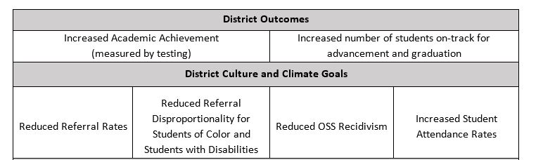
Preventative Strategies Goals

Slide 13
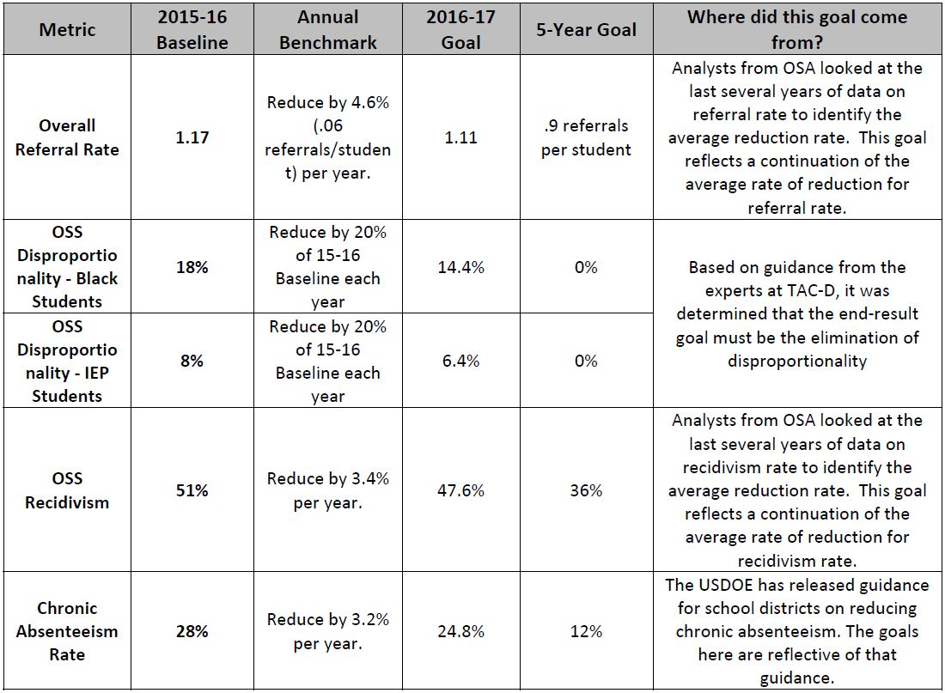
Preventative Strategies Goals

Slide 14

SchoolSTAT Objectives
Process Outcomes
Increase data literacy
Share best practices
Alignment in planning and increased accountability
Student Outcomes
PSP Goals
Increase student achievement
Increase equity for systematically marginalized groups

Slide 15
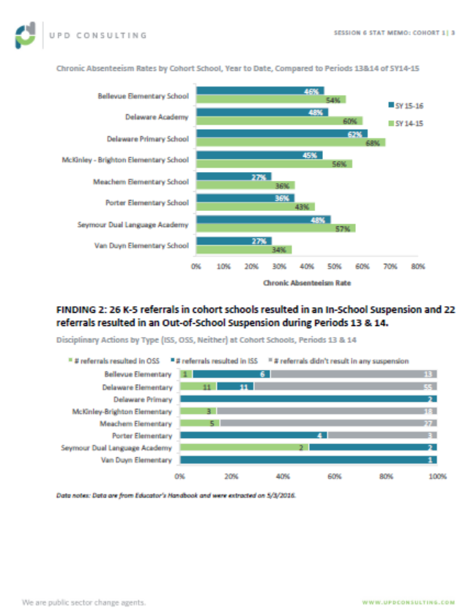



SchoolSTAT Process
Guardians of Equity Meeting
Cohort Meetings
Data Memo
SchoolSTAT
SLT or DSCT
CO & School Leaders
A.S. & Cohorts

Slide 16
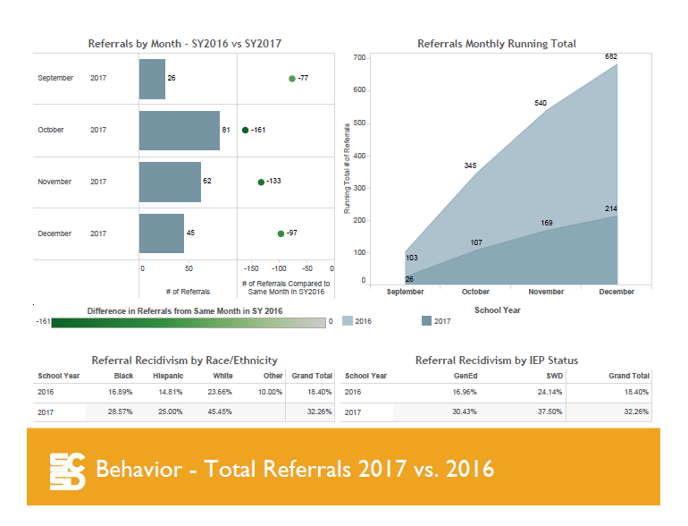
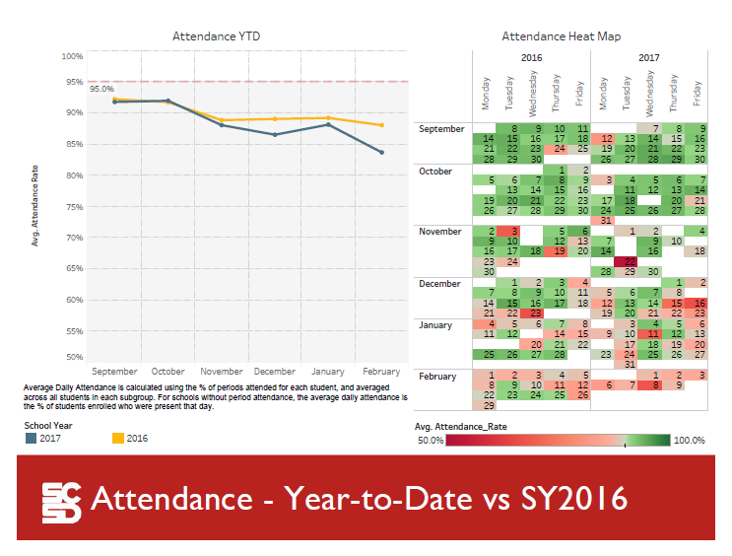
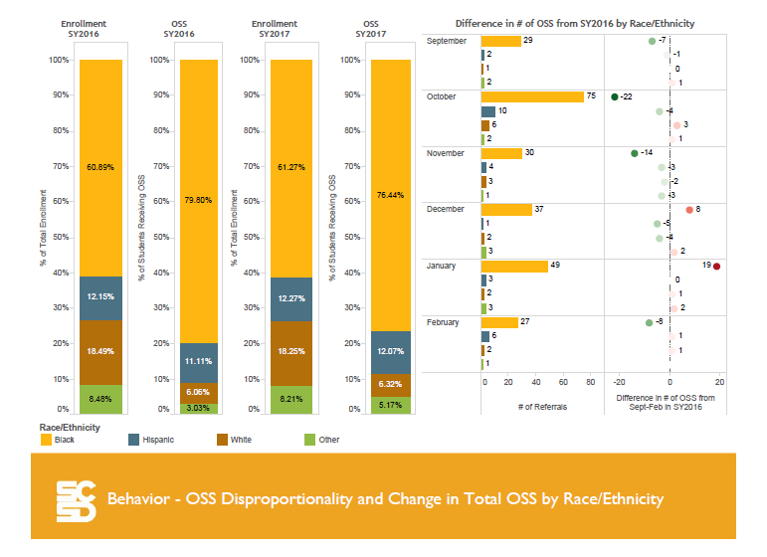
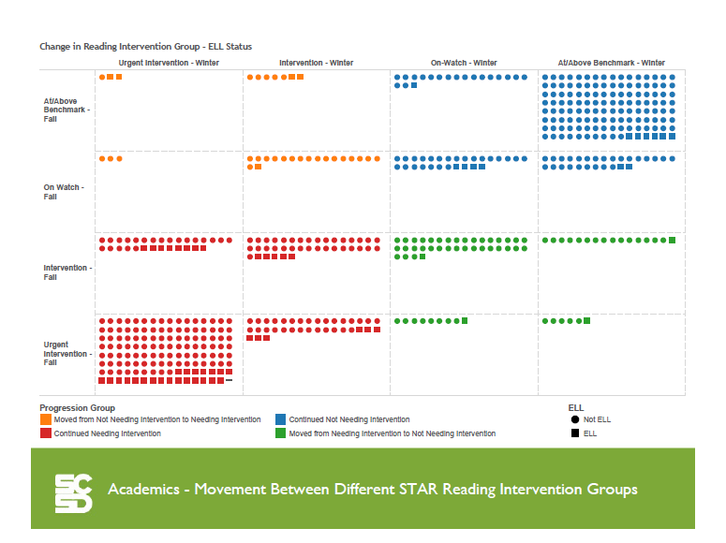
Data Memo

Slide 17
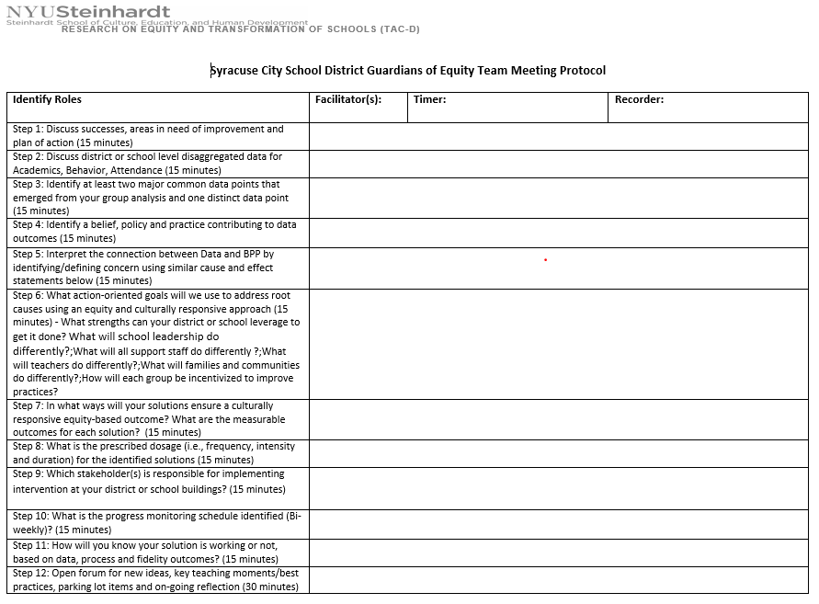
Guardians of Equity Meeting
Buildings work through Guardians of Equity protocol
Data coaches deployed as Central Office support

Slide 18
Guardians of Equity Meeting
Step 1: Reflect on current state of affairs in your building/district
Step 2: Discuss the disaggregated data
Step 3: ID two common data points and 1 distinct data point
Step 4: ID a belief, policy and practice contributing to the outcomes
Step 5: ID the relationship between the BPP and the data points
Step 6: Create SMART goals to address the root causes using equity and cultural responsiveness
Step 7: ID the measurable outcomes for each goals
Step 8: What is the prescribed dosage for the solutions?
Step 9: Which stakeholder is responsible for implementing the solution?
Step 10: What is the progress monitoring schedule?
Step 11: How will you know if it is working?
Step 12: Open forum for new ideas

Slide 19
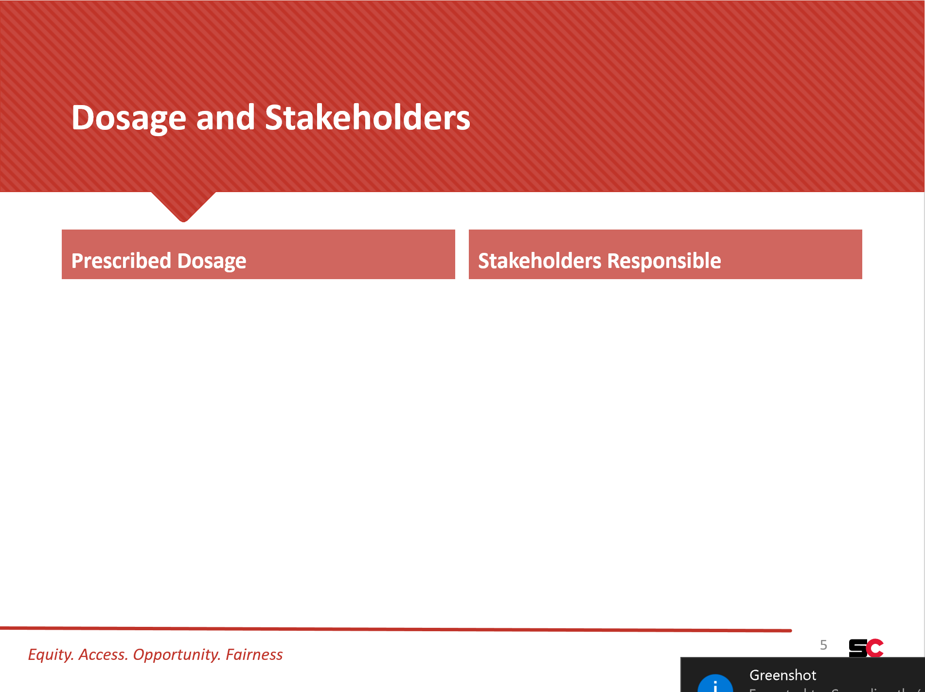
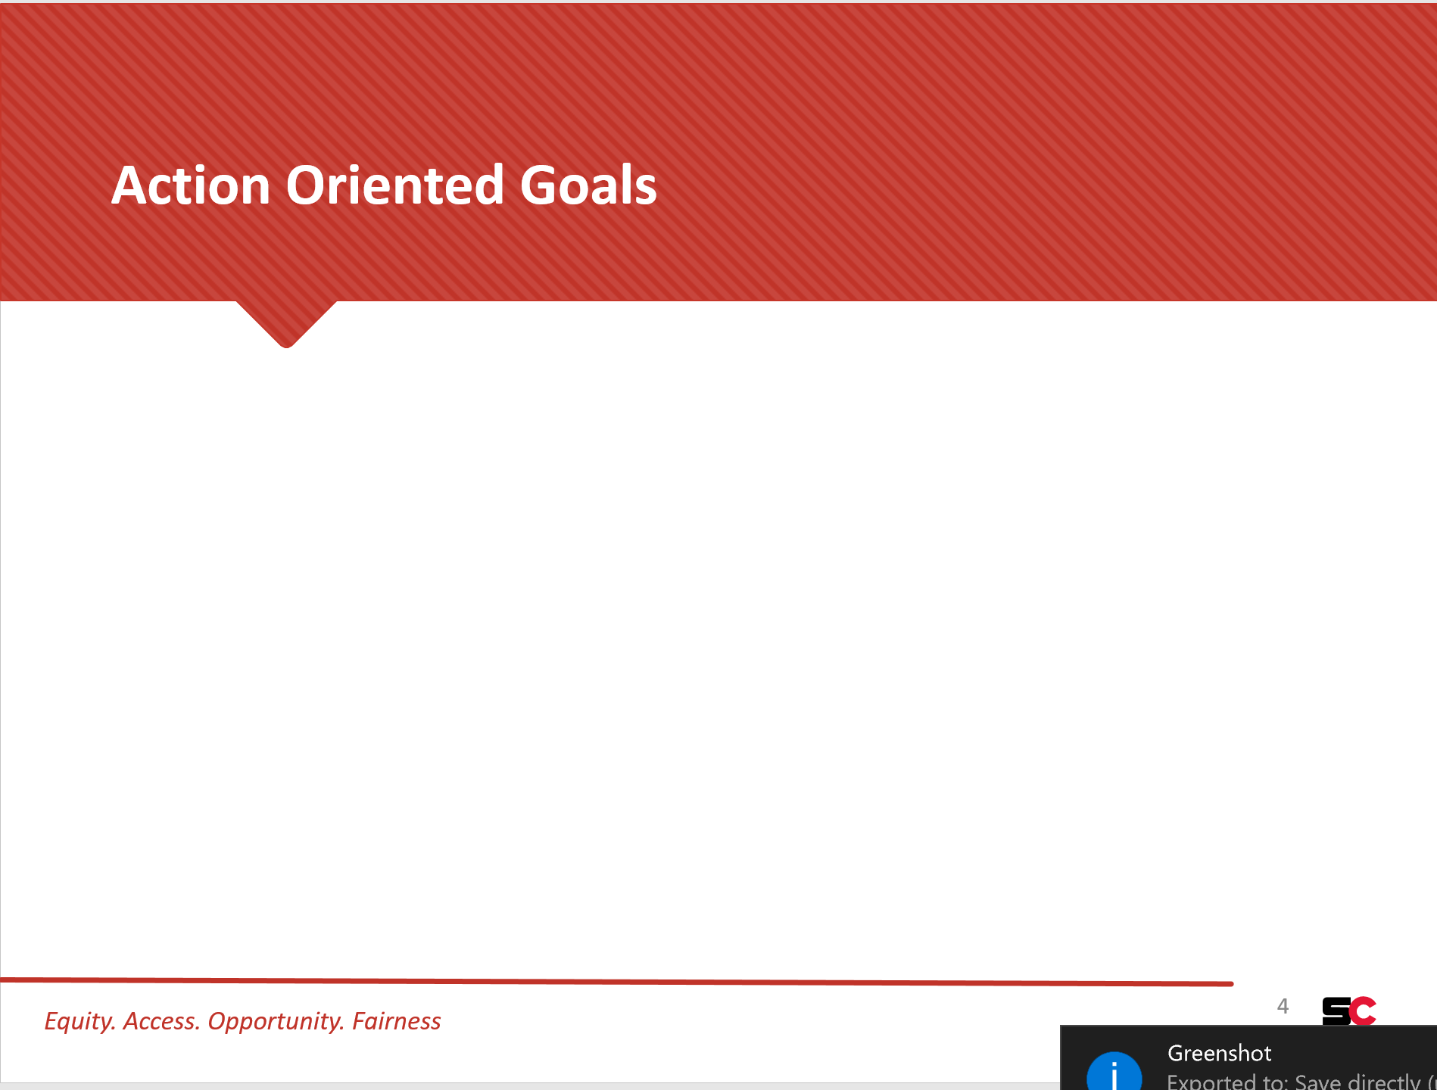
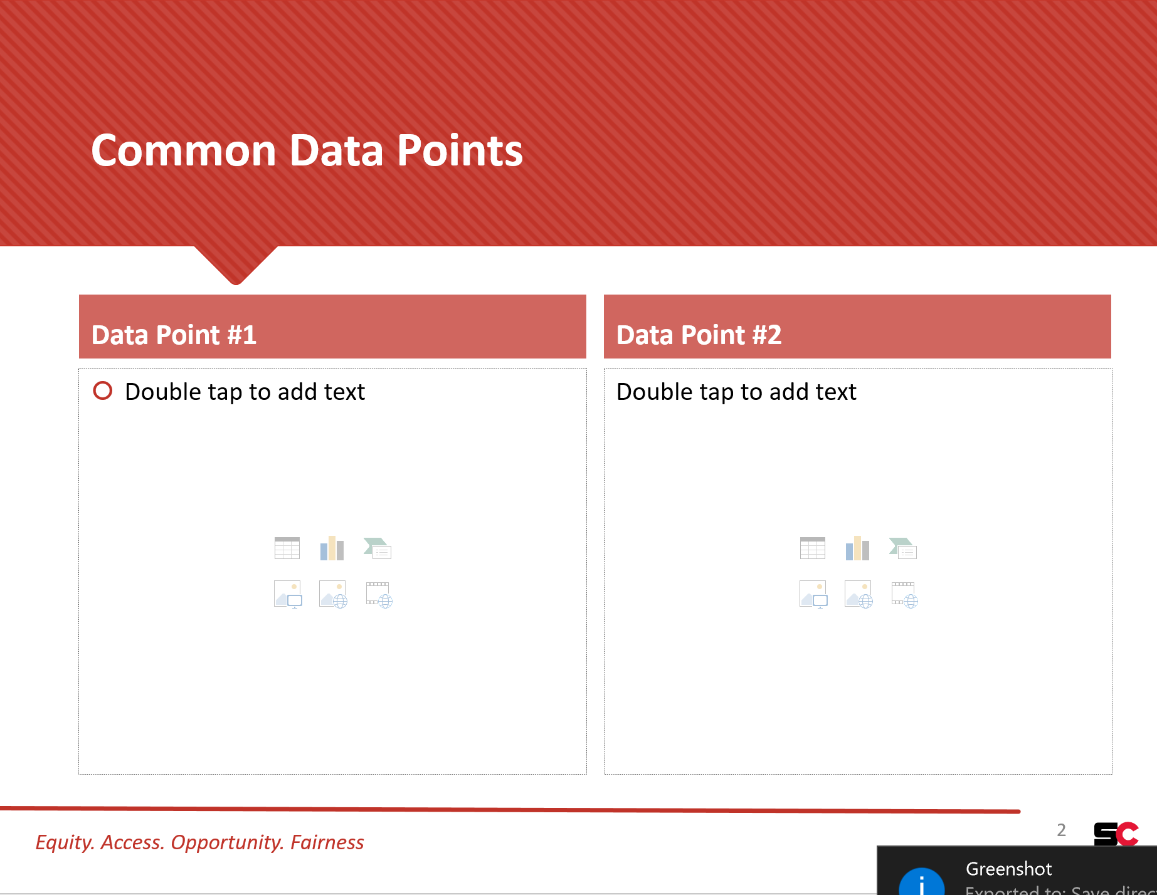
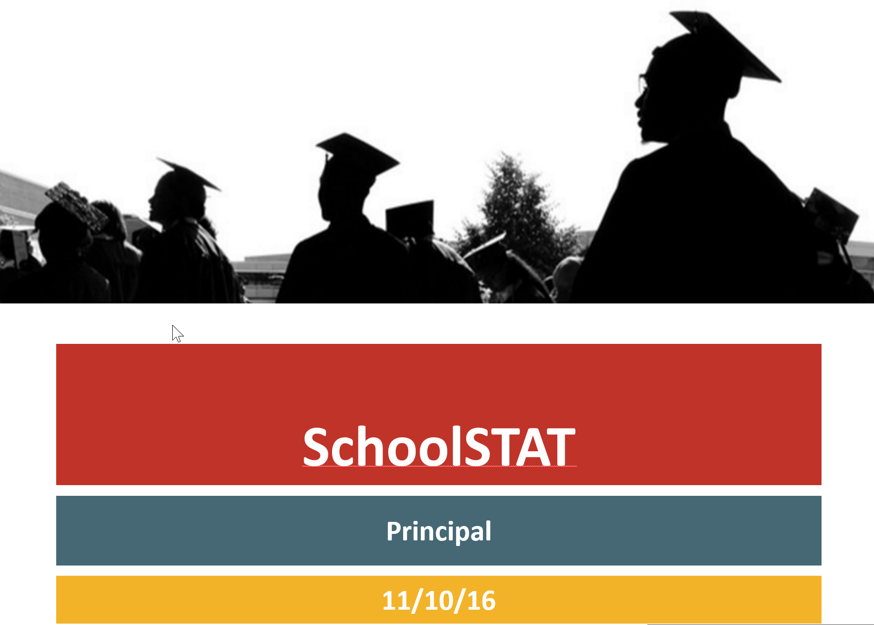
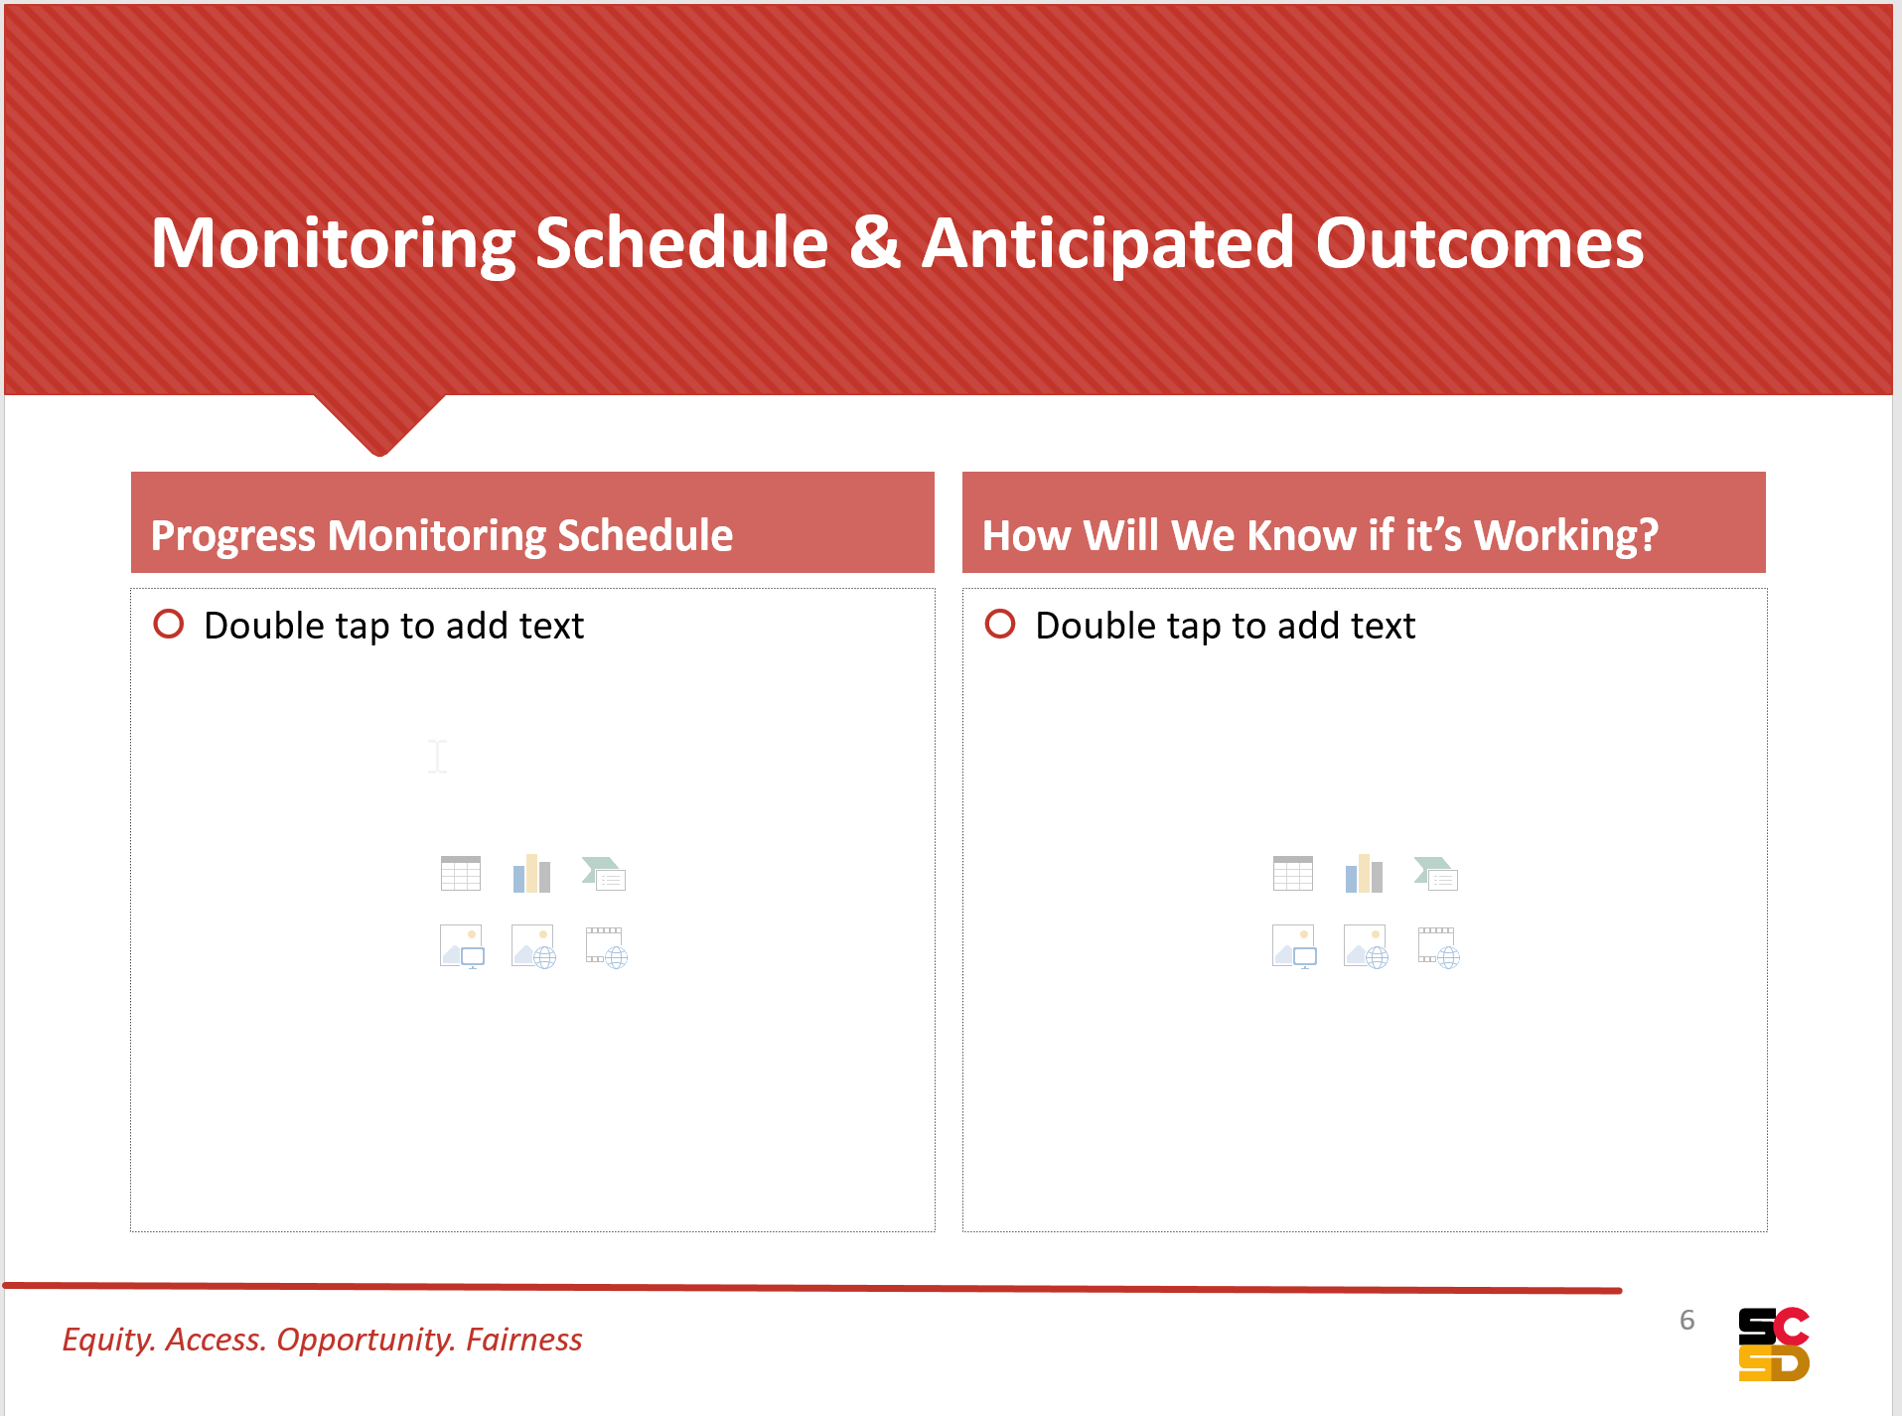
Guardians of Equity Meeting
19

Slide 20
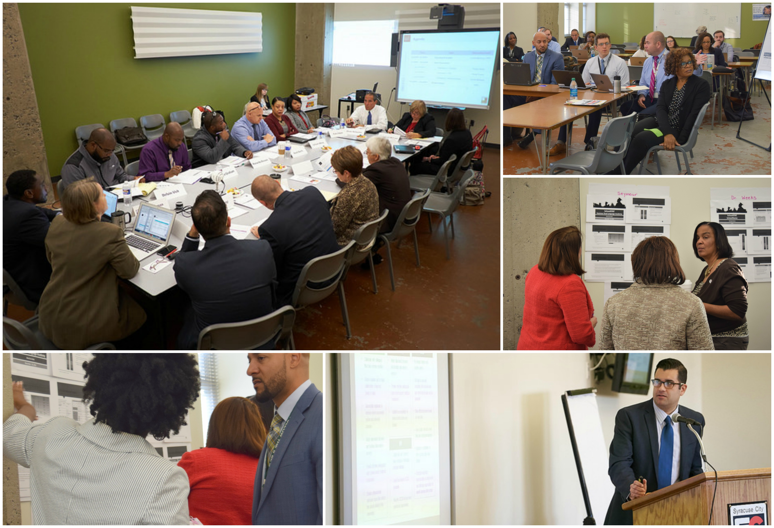
SchoolSTAT Session
School Goals and Action Summaries
Deep Dives into Best Practices
Celebrations
Notes:
How will we know if we have a successful session?
We CELEBRATED progress and growth
BEST PRACTICES were shared
Everyone took OWNERSHIP for the data
Conversations were CONNECTED and LINKED to other school improvement efforts
Action steps discussed and presented were DOABLE and MEASURABLE

Slide 21
SchoolSTAT Objectives
Process Outcomes
Increase data literacy
Share best practices
Alignment in planning and increased accountability
Student Outcomes
PSP Goals
Increase student achievement
Increase equity for systematically marginalized groups

Slide 22
Lessons Learned: Increase data literacy
Objective: Increase data literacy
Eliminate distractions from the data
Central Office support is critical
Modify the protocol to the needs of the District

Slide 23
Lessons Learned: Sharing best practices
Objective: Share best practices
Utility in having vertical and horizontal alignment
Building-level staff often view their situation as being unique and are resistant to suggestions
Facilitation is key

Slide 24
Lessons Learned: Alignment in planning and increased accountability
The connection with state required plans must be explicit (SIG, SCEP, Receivership, etc…)
Follow-up and progress monitoring must be constant and consistent
Use process for aligned management, rather than the “activity” of using data
Critical and direct feedback must be given to buildings on their goals and action steps (when appropriate)

Slide 25
Lessons Learned: Student Objectives
Concrete goals focus efforts at Central Office and in buildings
Buildings were not courageous with their goals
School goals were not related to systemic problems, rather specific, discrete challenges

Slide 26
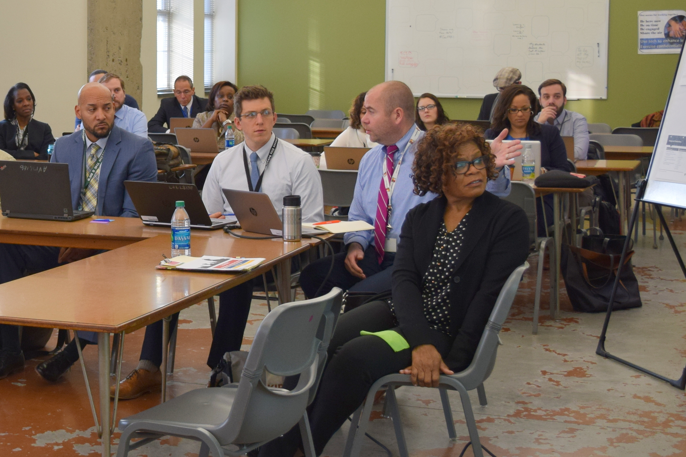
Takeaway
SchoolSTAT is a building-level focused structure
Disproportionality and a lack of cultural responsiveness are a District-wide problem
The District needs an equity vision and to involve all departments (HR, Finance, Operations, Data, Teaching and Learning)

Slide 27
Next Steps
1 Years remaining in AOD
5 year Culture and Climate goals
Academic goals developed for SY 2018
Equity Audits
Commitment to and refinement of SchoolSTAT process
Dashboards for immediate access to data
Syracuse Urban Fellowship Program

Slide 28

Questions

