Slide 1
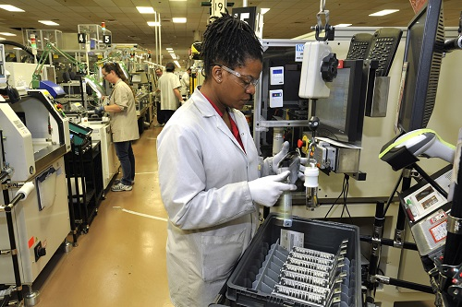
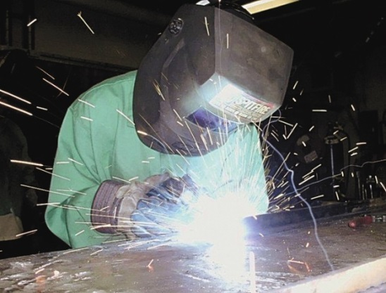
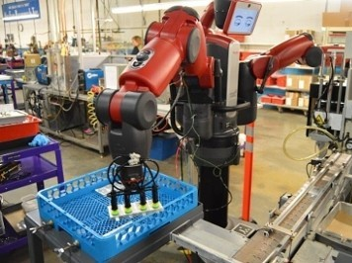
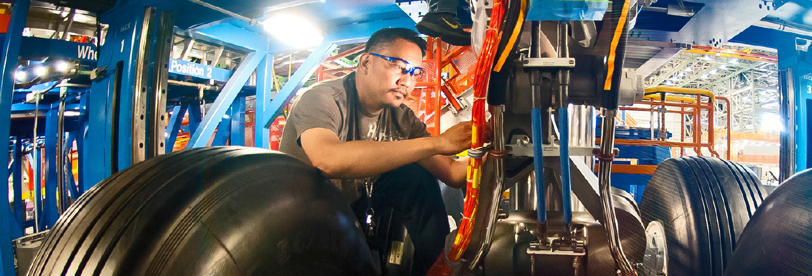
Careers in Manufacturing

Slide 2
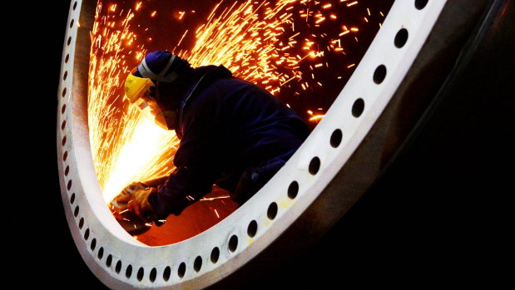
What Manufacturing Job is for You?
This survey is a tool that guides you toward careers that match your interests.
Its based on the theory that career choice is an expression of your personality.

Slide 3
What Manufacturing Job is for You?
Review six personality types and rank them from 1-6.
6 - profile that sounds the most like you.
1 - profile that sounds the least like you.

Slide 4
What Career is Best for You?
Turn to a partner and share the results of the survey.
Share what career you’re best connected with.
Share what career you’re least connected with.

Slide 5
Manufacturing
“The process of converting raw materials, components, or parts into finished goods that meet a customer's expectations or specifications”.

Slide 6
Manufacturing
Can we agree….
Every item has been “manufactured”.

Slide 7

Manufacturing
Are all items “manufactured” by humans?

Slide 8
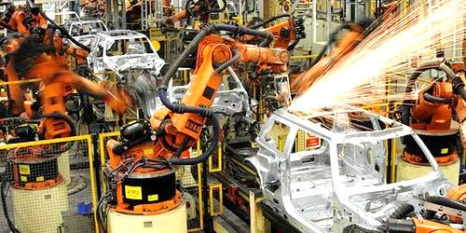
Manufacturing
Robotics – Things made by robots.
Are humans involved? If yes….how?

Slide 9
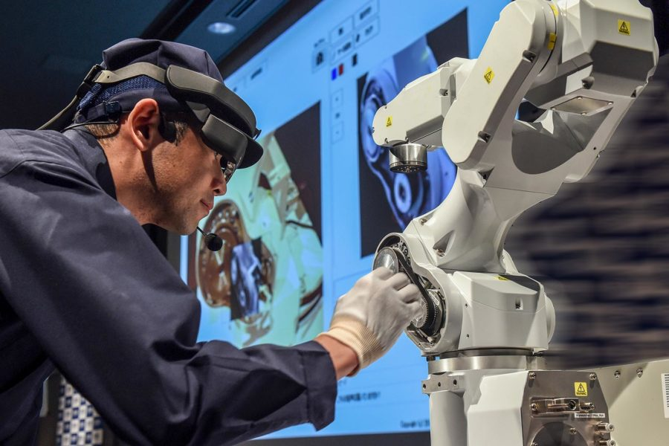
Manufacturing
Designing and Building Robots…Manufacturing?

Slide 10
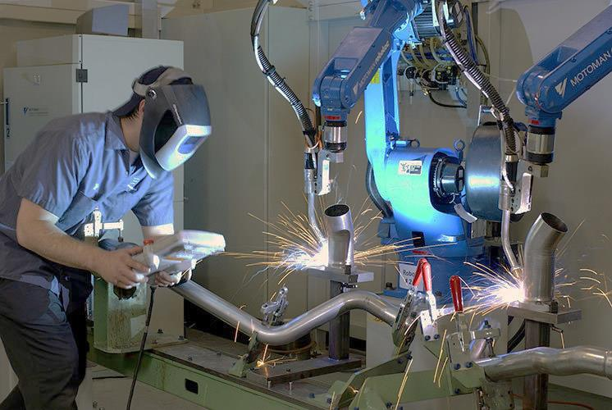
Manufacturing
Programming…Manufacturing?

Slide 11
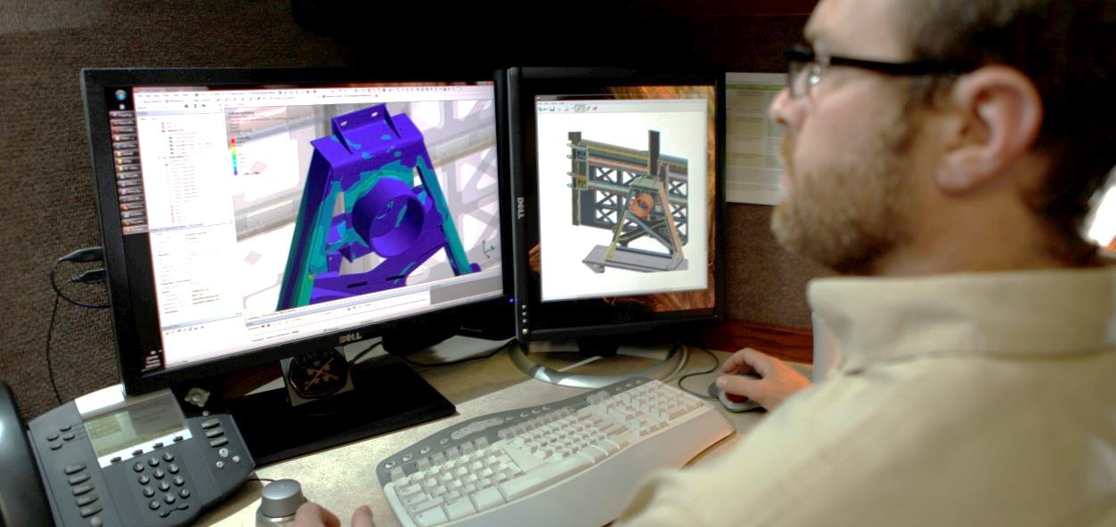
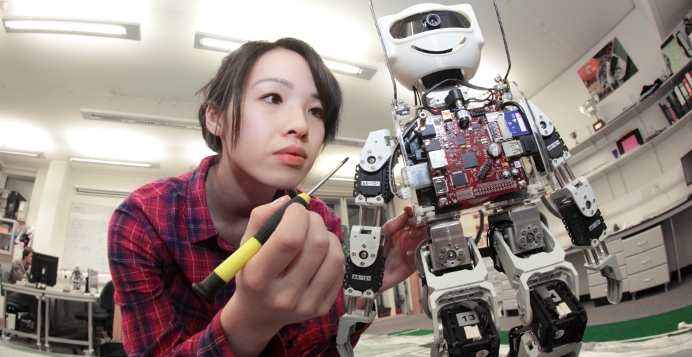
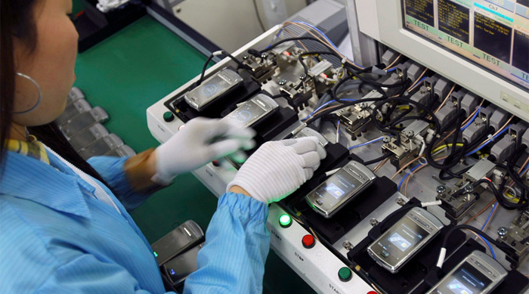
Manufacturing
Design
Build Prototype
Manufacture

Slide 12

Careers in Manufacturing

Slide 13
Manufacturing Jobs
Project…
Working in teams select one career in manufacturing.
Create a “job posting” poster for that career that would be posted on indeed.com, monster.com, ziprecruiter.com, ect…
Share with the class

