Slide 1
Holland Code
John Holland's Six Personality Types

Slide 2
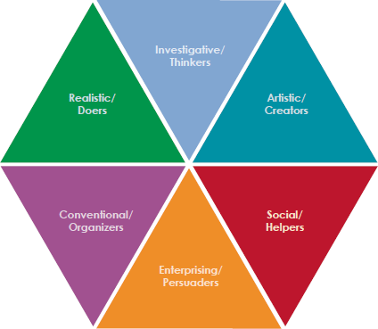

Slide 3
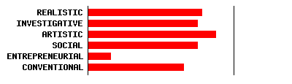
My Results

Slide 4
Realistic
•Likes to work with animals, tools, or machines; generally avoids social activities like teaching, healing, and informing others.
•Has good skills in working with tools, mechanical or electrical drawings, machines, or plants and animals.
•Values practical things you can see, touch, and use like plants and animals, tools, equipment, or machines.
•Sees self as practical, mechanical, and realistic.

Slide 5
Investigative
•Likes to study and solve math or science problems; generally avoids leading, selling, or persuading people
•Is good at understanding and solving science and math problems
•Values science
•Sees self as precise, scientific, and intellectual

Slide 6
Artistic
•Likes to do creative activities like art, drama, crafts, dance, music, or creative writing; generally avoids highly ordered or repetitive activities
• Has good artistic abilities -- in creative writing, drama, crafts, music, or art
•Values the creative arts -- like drama, music, art, or the works of creative writers
•Sees self as expressive, original, and independent.

Slide 7
Social
•Likes to do things to help people -- like, teaching, nursing, or giving first aid, providing information; generally avoids using machines, tools, or animals to achieve a goal
•Is good at teaching, counseling, nursing, or giving information
•Values helping people and solving social problems
•Sees self as helpful, friendly, and trustworthy

Slide 8
Enterprising
•Likes to lead and persuade people, and to sell things and ideas; generally avoids activities that require careful observation and scientific, analytical thinking
•Is good at leading people and selling things or ideas
•Values success in politics, leadership, or business
•Sees self as energetic, ambitious, and sociable

Slide 9
Conventional
•Likes to work with numbers, records, or machines in a set, orderly way; generally avoids ambiguous, unstructured activities
•Is good at working with written records and numbers in a systematic, orderly way
•Values success in business
•Sees self as orderly, and good at following a set plan

